Slide 1
EEG Case Study
Case 3
Gergana, Ivaylo, Nikolay, Yanko
28.06.2026
Summer School

Slide 2
Presentation Overview
Background
EEG Device
Five Research Questions
Results
Discussion
Conclusions

Slide 3
Research Background & Objectives
Experimental Design
Collecting Data
The 5 Research Questions
AI vs Human Coding
Person Identification
Activity Classification
Gender Differences in the EEG
Attention Span

Slide 4
EEG Device
Device overview
Key specifications
Advantages & limitations
Delta(δ) 0.5 - 4 Hz Dreamless sleep (deep meditation)
Theta(θ) 4 - 8 Hz Deeply relaxed, inward focused (drowsiness, vivid dreams)
Alpha(α) 7.5 - 13 Hz Very relaxed, passive attention (thoughtful times, reflective, restful)
Beta(β) 13 - 30 Hz Anxiety dominant, active, external attention, relaxed (busy mind)
Gamma(γ) 30 - 44 Hz Concentration (higher levels of consciousness, problem solving)

Slide 5
Experimental Design
Participants
Protocol
Tasks
Data acquisition
Preprocessing

Slide 6
Preprocessing
Sentinel removal
KNN interpolation
Band-pass (1–50 Hz)
Notch (50 Hz)
Epoch creation - 2s
Amplitude threshold

Slide 7
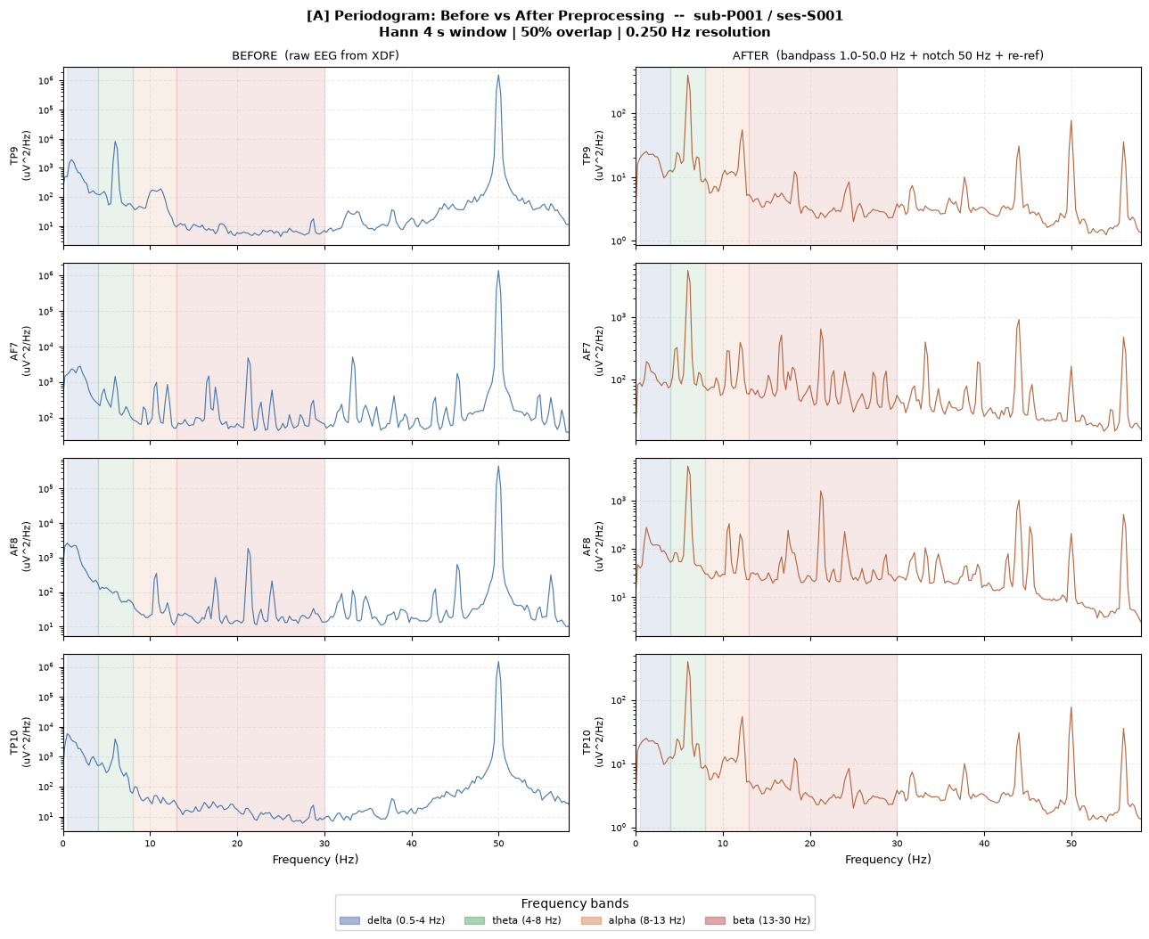
Preprocessing

Slide 8
Feature engineering
Segmentation: The original time-domain signal is broken down into smaller subsections, which often overlap (e.g., 50% overlap).
Windowing: A mathematical window function (such as a Hann or Hamming window) is applied to each subsection to mitigate spectral leakage.
Periodogram Calculation: The periodogram (the squared magnitude of the Fast Fourier Transform, or FFT) is computed for each individual windowed segment.
Averaging: These individual periodograms are averaged together to produce a single, smoothed PSD estimate

Slide 9
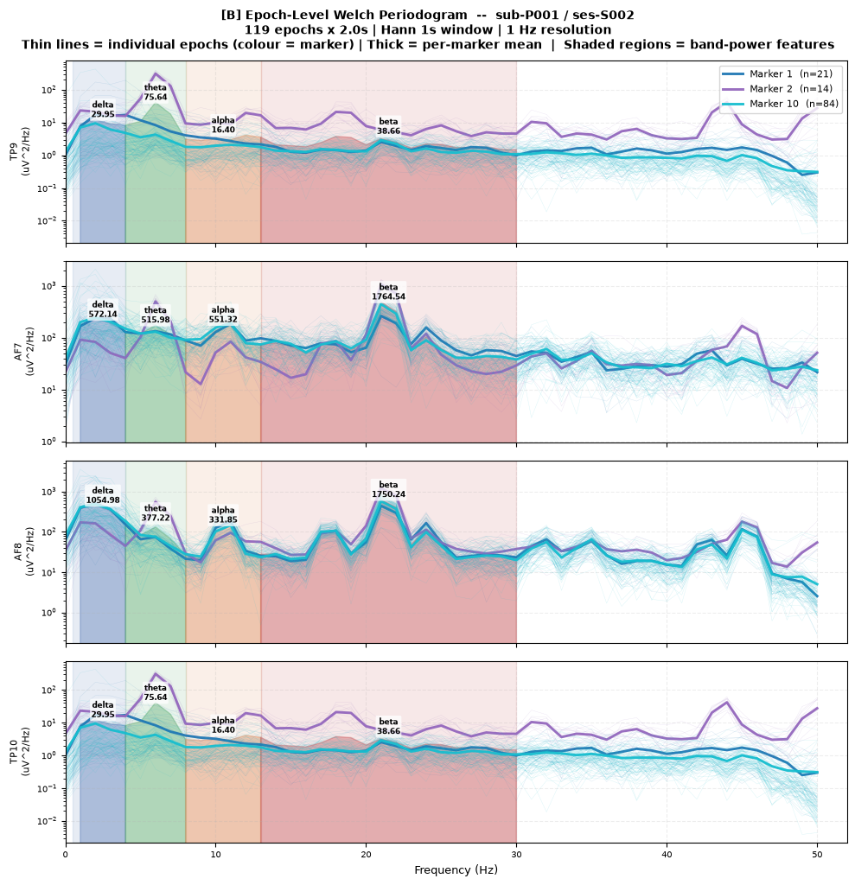

Slide 10
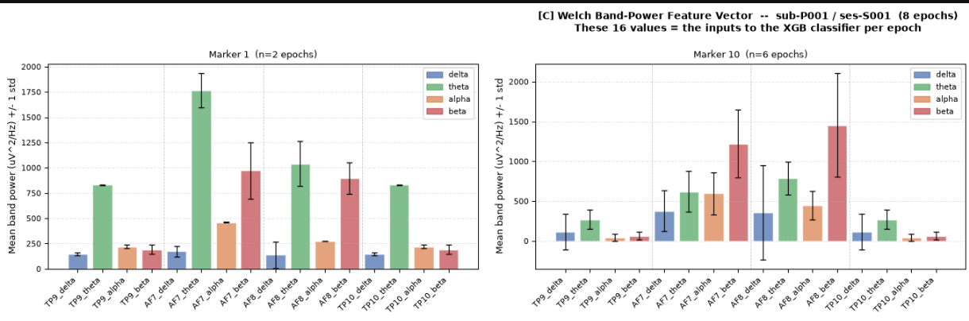
Feature engineering
2 s non-overlapping epochs → Welch PSD → **16 features** (4 bands × 4 channels)

Slide 11
Case 1 - AI vs. Human Coding (vs. Neutral Baseline)
Objective
Method

Slide 12
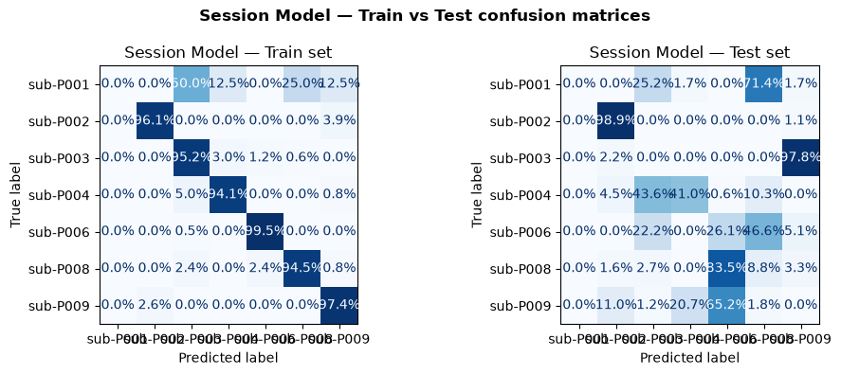
Case 2 - Person Identification (EEG Biometrics)

Slide 13
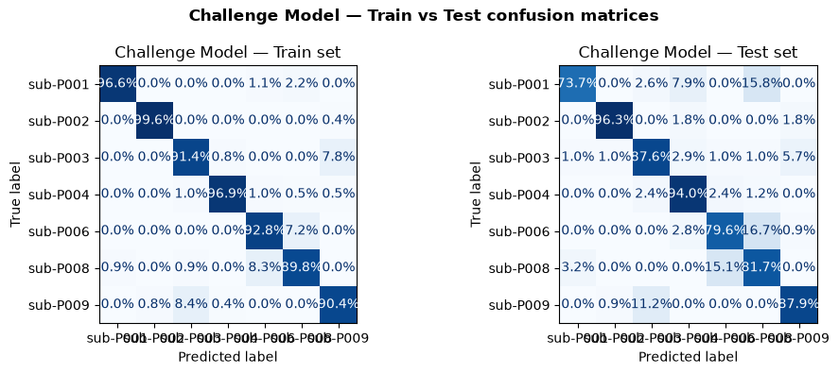
Case 2 - Person Identification (EEG Biometrics)

Slide 14
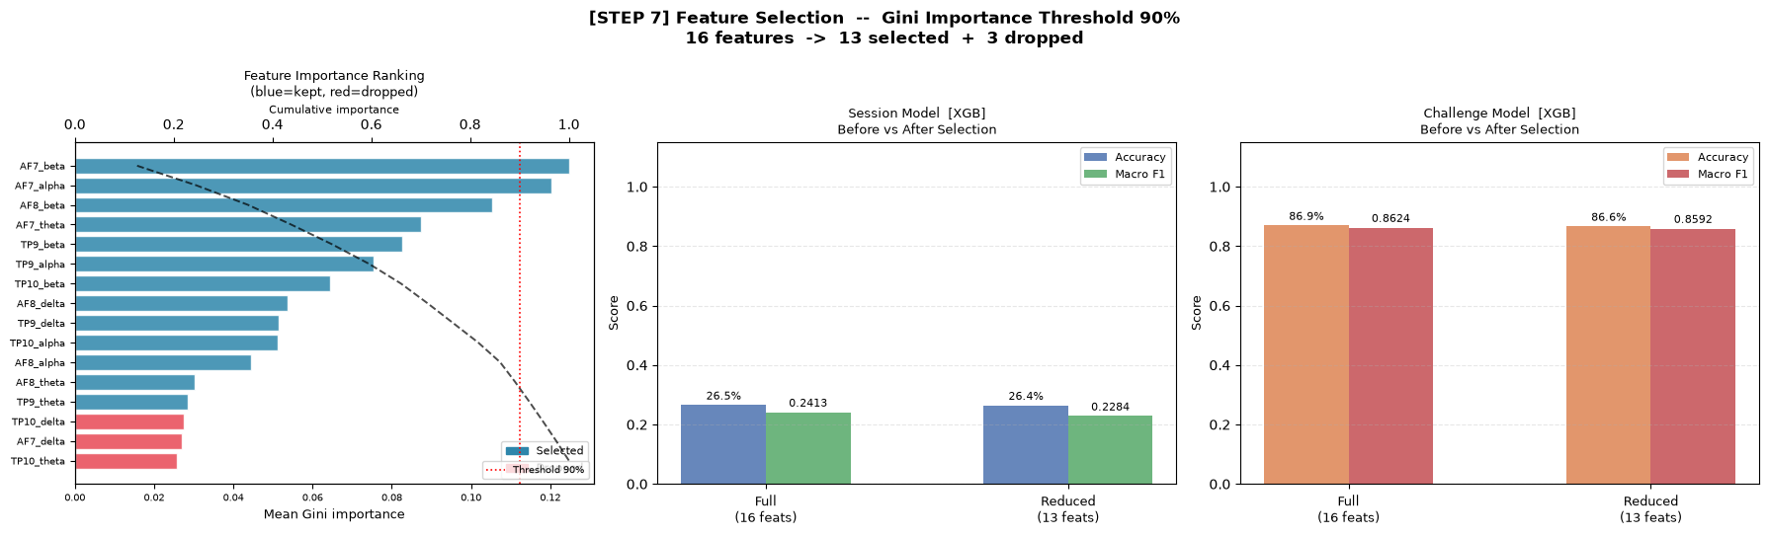
Case 2 - Person Identification (EEG Biometrics)

Slide 15
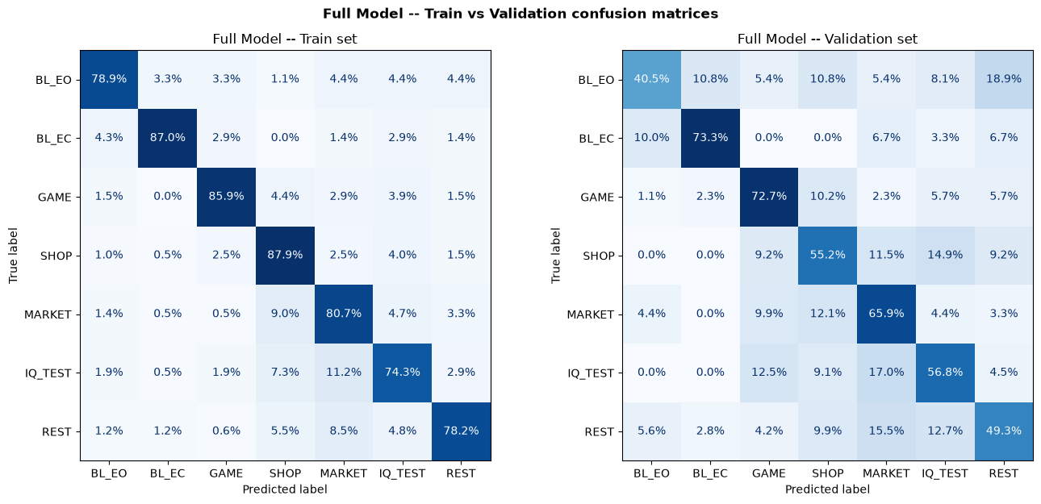
Case 3 - Activity Classification

Slide 16
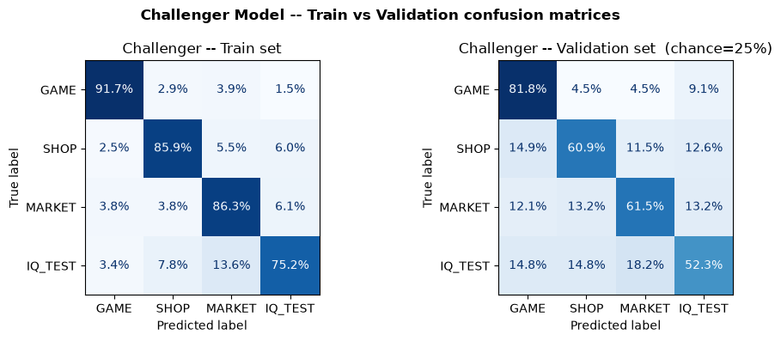
Case 3 - Activity Classification

Slide 17
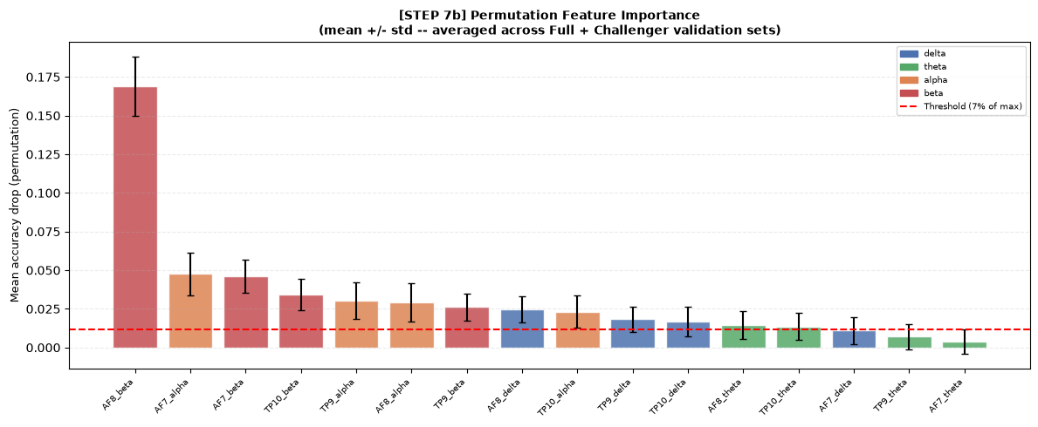
Case 3 - Activity Classification

Slide 18
Case 4 - Sex Differences in Resting-State EEG
Objective
Method

Slide 19
Case 5 - Attention Span Across Content Types
Objective
Method
Results
Key finding

Slide 20
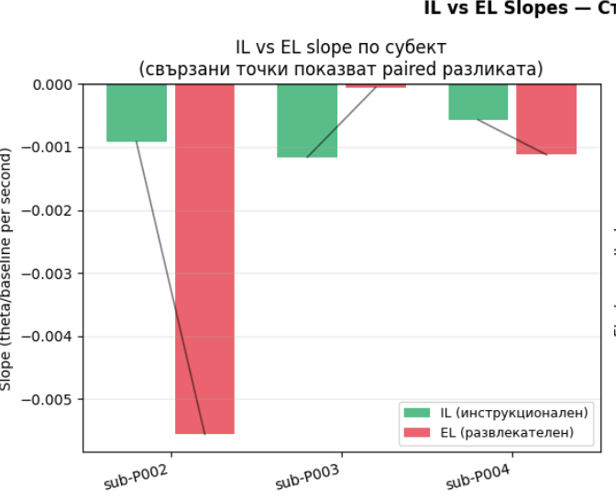

Slide 21
Overall Results
Summary
Limitations

Slide 22
Conclusions & Future Work
Main conclusions
Practical implications
Future research

Slide 23
Thank you!

